Slide 1
Addressing Demographic Trends: A predictive Model
Filis Coba, M.S.
Manisha Gupta, Ph.D.
Pablo Salcedo, M.D.

Slide 2
Area of Concern
Future global demographic trends
Aging/developed societies
Expanding/developing societies
Model Goals
To add awareness and evidence for policy action and research for national governments and population scientists through a predictive model

Slide 3
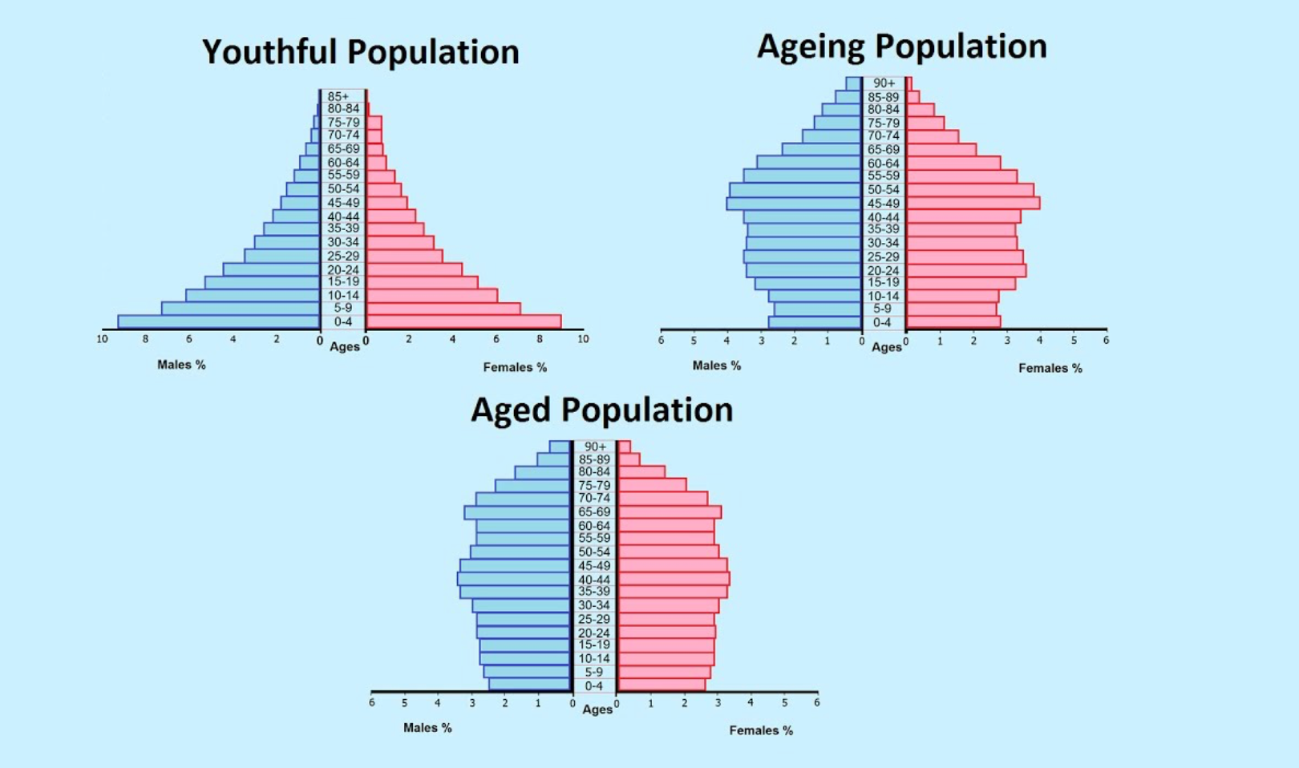
Global Demographic Trends
Notes:
All country populations in the world can be placed into 3 demographic camps. An expanding (aka youthful population), an aging (contracting) population, and an aged( aka stabilized population). The three different groups have major implications for a country’s future prospects (both socially and economically). Being aware of where a country stands in relation to others provides valuable insight into how governments and policy makers should act in order to promote a peaceful and prosperous transition into the future. As demographic trends are generational, effects of current actions are not felt until decades later, so procrastination is not an option.
In a youthful population: there is a high fertility rate, but often a high death rate. The population skews heavily on the young side with a wide base and due to effects of reduced longevitity, taper off dramartically with age—think developing countries like Nigeria and India
In an aged population: the population pyramid is top heavy thanks to high life expectancy but narrow at the base secondary to low birth rates and/or reduced immigration. This developed countries, think western European countries face shrinking populations
In an aged population, such as the United States, there is a less dramatic population pyramid an a more static progression in age groups; high life expectancy rates are characteristic, and birth rates although lower than youthful population groups, are above ageing population groups and often offset by immigration trends

Slide 4
Global Demographic Trends
Notes:
Left: ageing population of China, in which total population will actually begin to fall after peaking in the upcoming years.
Right: youthful population of India, projected to surpass China as the worlds most populous county in the upcoming years
Two very different trends with very different implications.
While an ageing country like China will face a ballooning population of seniors and a smaller group of working aged individuals to support them, India will be occupied with increasing longevity and life expectancy while improving quality of life.
It is apparent that awareness of a country’s demographic projection is key to directing policy and preventative measures for the future.

Slide 5
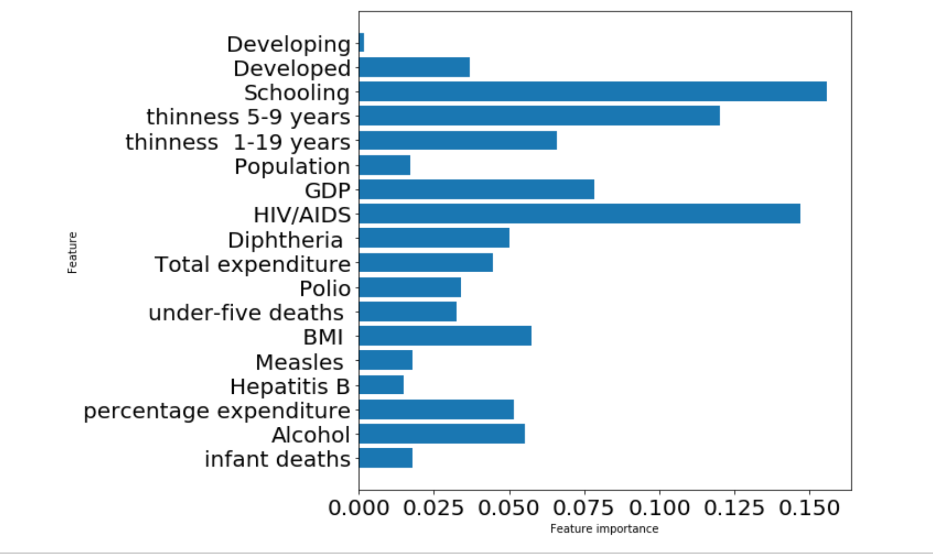
Classification Model: Random Forest
Classification Schema:
High life expectancy country
Low life expectancy country
Source:
World Health Organization
Accuracy of model on testing data: 93%
Features analyzed included:
Notes:
In an effort to provide a means of classification for countries: we created a prediction model to classify countries as high life expectancy vs low life expectancy with the assumption that high life expectancy would serve as a proxy for developed/contracting countries and low life expectancy a proxy for developing/expanding countries. We utilized median life expectancy is a cut off threshold for classification The idea being that by examining modifiable factors that affect population trends, we could provide insight into ways governments could address the unique needs of their countries now.
Status Developed or Developing status
Life expectancy Life Expectancy in age
Adult Mortality Adult Mortality Rates of both sexes (probability of dying between 15 and 60 years per 1000 population)
infant deaths Number of Infant Deaths per 1000 population
Alcohol Alcohol, recorded per capita (15+) consumption (in litres of pure alcohol)
percentage expenditure Expenditure on health as a percentage of Gross Domestic Product per capita(%)
Hepatitis B Hepatitis B (HepB) immunization coverage among 1-year-olds (%)
Measles Measles - number of reported cases per 1000 population
BMI Average Body Mass Index of entire population
under-five deaths Number of under-five deaths per 1000 population
Polio Polio (Pol3) immunization coverage among 1-year-olds (%)
Total expenditure General government expenditure on health as a percentage of total government expenditure (%)
Diphtheria Diphtheria tetanus toxoid and pertussis (DTP3) immunization coverage among 1-year-olds (%)
HIV/AIDS Deaths per 1 000 live births HIV/AIDS (0-4 years)
GDP Gross Domestic Product per capita (in USD)
Population Population of the country
thinness 1-19 years Prevalence of thinness among children and adolescents for Age 10 to 19 (% )
thinness 5-9 years Prevalence of thinness among children for Age 5 to 9(%)
Income composition of resources Human Development Index in terms of income composition of resources (index ranging from 0 to 1)
Schooling Number of years of Schooling(years)
The Human Development Index (HDI) is a statistical tool used to measurea country's overall achievement in its social and economic dimensions. The social and economic dimensions of a country are based on the health of people, their level of education attainment and their standard of living.

Slide 6
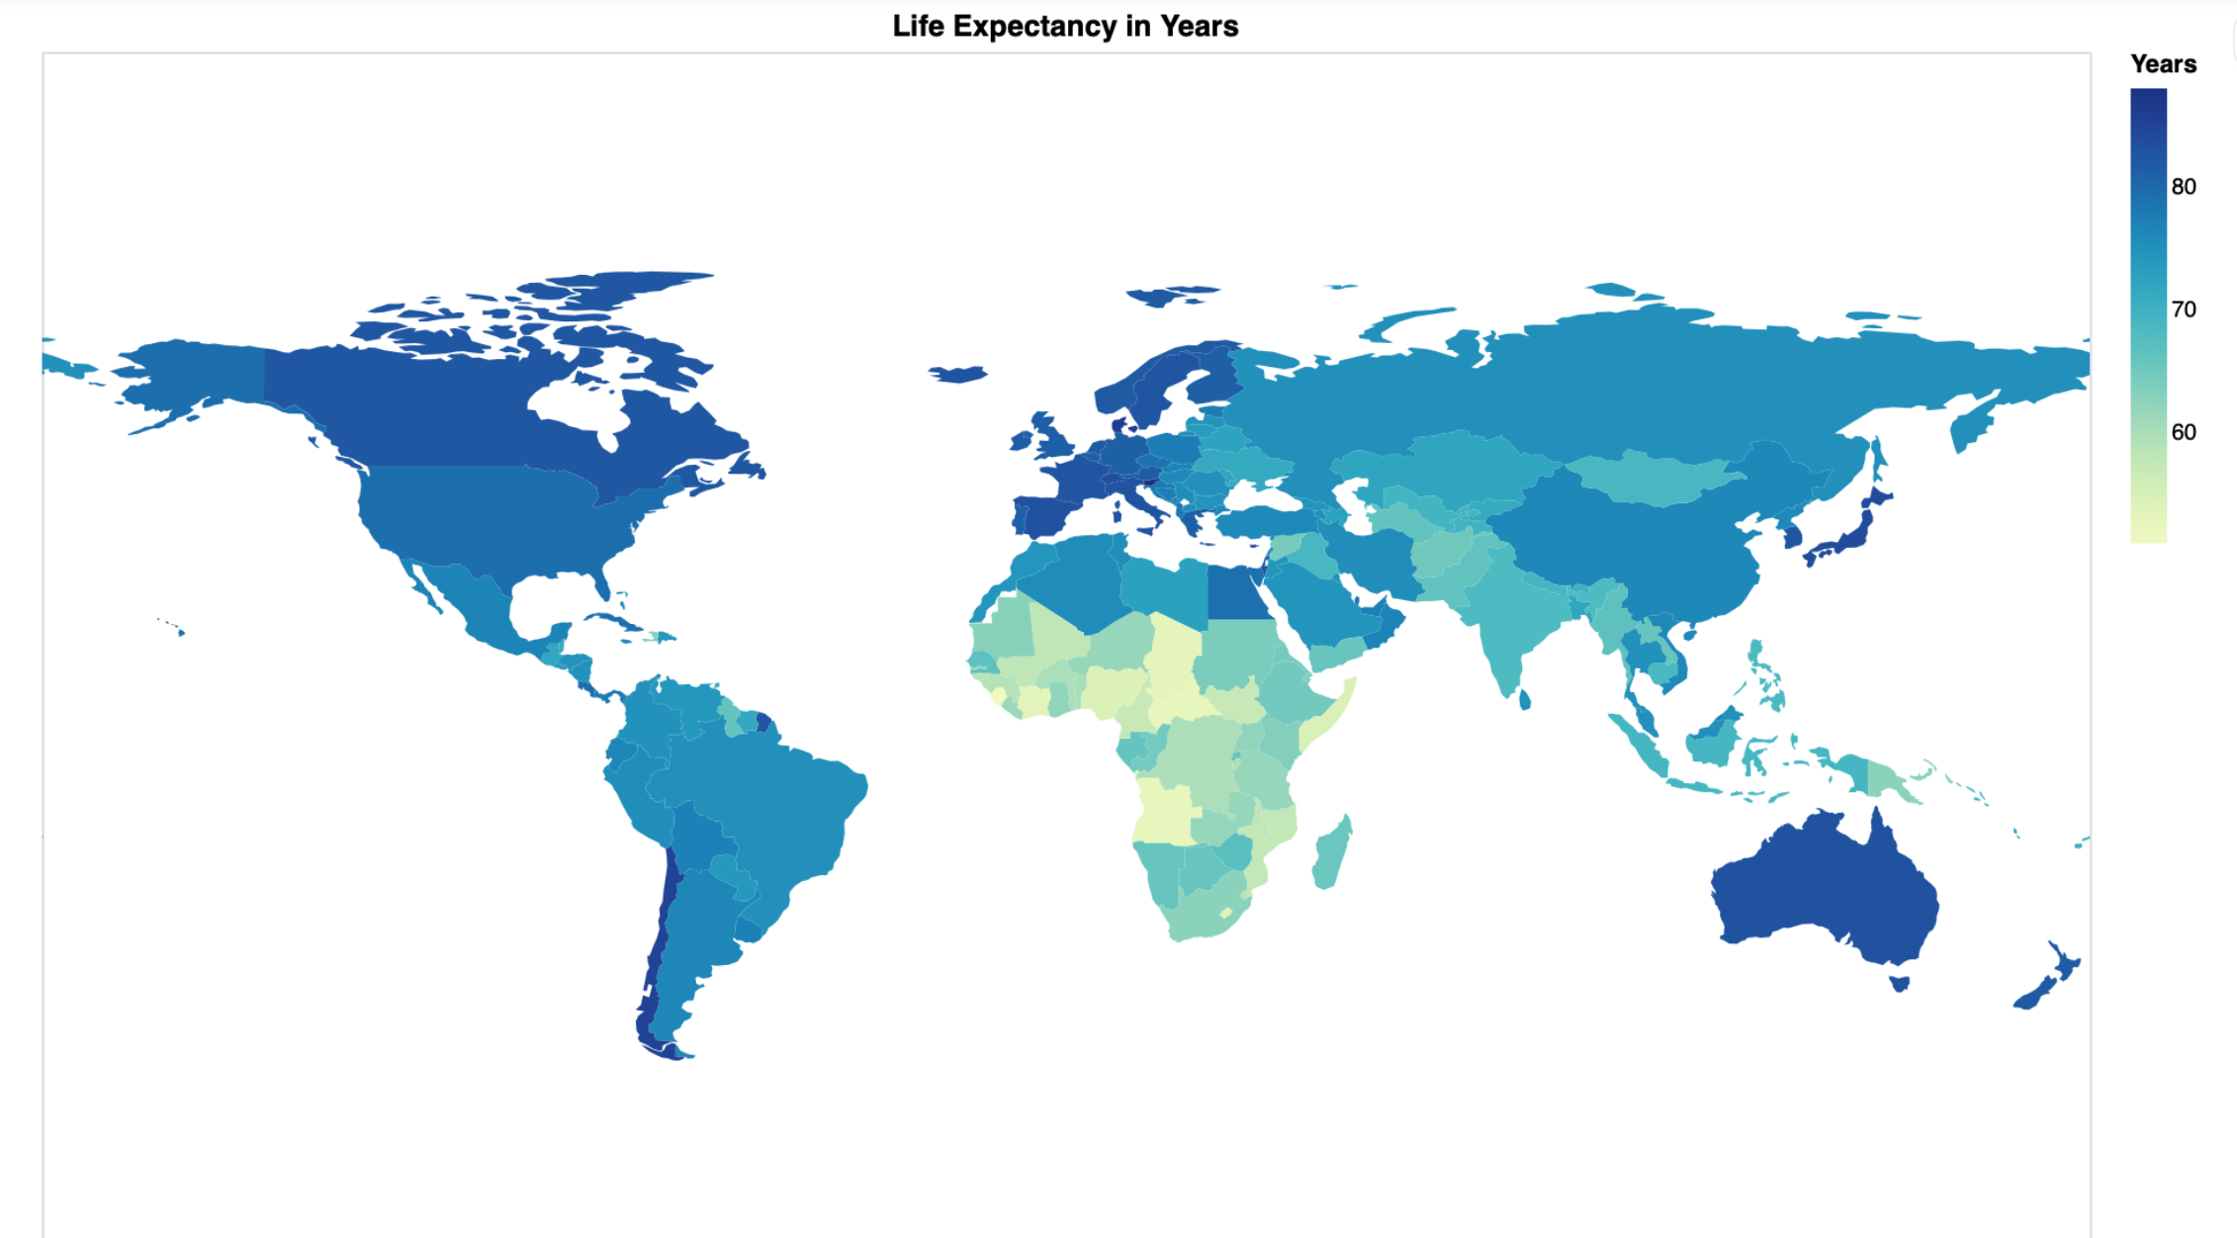
CONCLUSIONS
A tool to aid in more
proactively addressing
demographic trends of a
country
Notes:
By classifying countries into two groups based off of life expectancy, we are able to better understand not only where a country is in terms of their demographic breakdown but where they are headed. By examining population trends, governments can be in a better, more informed position when governing their people.
Whether you are high life expectancy country with an ageing society in need of immigration reform and better m

Slide 7
References
World Health Organization Database
www.visualcapitalist.com
QUESTIONS?

